Slide 1
Sync Study Supplementary
SyncStudy Team

Slide 2
Table of content
Introduction
Pain Points
Methodology
Evaluation
Conclusion

Slide 3
INTRODUCTION

Slide 4
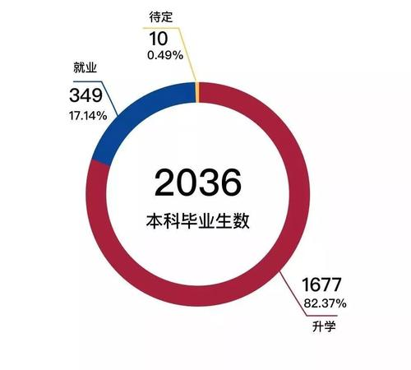
80% XJTLUer go to graduate studies abroads

Slide 5
Pain points

Slide 6

XJTLU students do not fully utilize resources at school
The educational resources provided outside the campus are expensive and with unguaranteed educational quality.
Many XJTLUers choose external resources for learning rather fully utilize the resources at school

Slide 7

People do not want complex
Too widely spread resources are preventing them from fully utilize the resources in school.
ILEAD
SURF
IETE
SE
By providing the beneficial resources for students in one platform, they will develop a habit to use this app, whenever they want to make some improvements for their profile in postgraduate study!

Slide 8
methodology

Slide 9
Building ability development platform
User Start
Graduate
Team Start
Input Major
Profile Update
Model Building
Credits Upload
Resources Collecting
Show 6 dimensions
Take task
Platform Building
Choose dimensions to improve
Suggest Corresponding
Improvement
Platform

Slide 10
6 Dimensions for Postgraduate Study
Input Ability
Output Ability
GPA
Internship
Choose Me
for Example
TOEFL/IETLS
Research
GRE
Project

Slide 11
Research Demo
ILEAD research-led study competition
ILEAD interdisciplinary competition
SUM
SURF Volunteer
SURF Candidate
Supervisor’s own research project assistant
Collaborative Project
Final Year Project

Slide 12
evaluation

Slide 13
I will use it!
It helps me to improve my abilities by fully utilize resources in XJTLU

Slide 14
conclusion

Slide 15

Without XJTLU, without me today
Truly, it is the full utilization of resources in XJTLU that makes me me!
I want more and more students to fully become a stronger young adults!
We need Angel fund’s support in better serve us students

Slide 16
We really need the help of Angel Funds and guidance of your expert judges’! Thank you
Sync Study Team

